Slide 1
Lending Club Case Study
Group Members Tarun Surya Prakash Prasanna M

Slide 2
Problem Statement
We work for a consumer finance company which specializes in lending various types of loans to urban customers. When the company receives a loan application, the company has to make a decision for loan approval based on the applicant’s profile. Two types of risks are associated with the bank’s decision:
If the applicant is likely to repay the loan, then not approving the loan results in a loss of business to the company
If the applicant is not likely to repay the loan, i.e. he/she is likely to default, then approving the loan may lead to a financial loss for the company
The aim of this case study is to identify patterns which indicate if a person is likely to default, which may be used for taking actions such as denying the loan, reducing the amount of loan, lending (to risky applicants) at a higher interest rate, etc.

Slide 3
Analysis approach
In this case study, we have used EDA to understand how consumer attributes and loan attributes influence the tendency of default.
Following steps are followed in the analysis:
Visualizing the data set
Data Cleaning
Handling of missing values
Addition of derived metrics
Univariate analysis
Bivariate analysis
Conclusion

Slide 4
Data Cleaning
Steps followed in the data cleaning
Clean of the CSV file/data set as per the requirement by deleting the rows and columns which are having null values and unnecessary for analysis
Cleaning of data resulted in reduction of columns from 111 to 26

Slide 5
Handling Missing/less information providing columns Values
Delete/drop the columns which are having missing information more than 90% (as they do not yield proper results)
This resulted in the reduction in number of columns to 21.

Slide 6
Derived Metrics
Year and Month columns are added using issue_d column.
Categorical division as per the data type of the variable is done.
Loan Amount
Annual Income
Interest Rate
Debt to Interest Ratio

Slide 7
Univariate Analysis
Univariate analysis is performed on the following variables.
Loan Status
Loan Amount
Funded Amount
Investors' Funded Amount
Annual Income
Employment Length

Slide 8
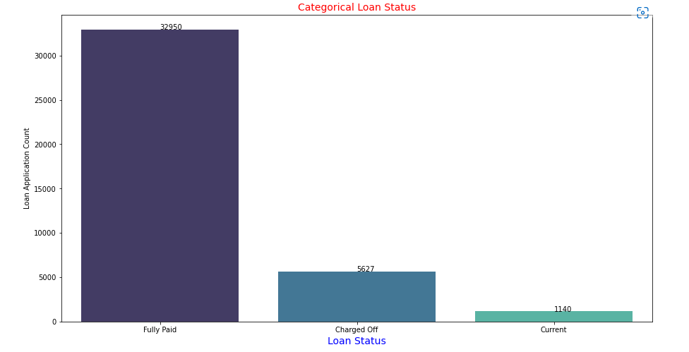
Observations from Univariate Analysis
Loan amount is in the range 5000 to 15000.
Around 14.16% loans were charged off out of total loan issued.
Loan status is
Fully Paid | 83 %
Charged off | 14 %
Current | 3 %

Slide 9
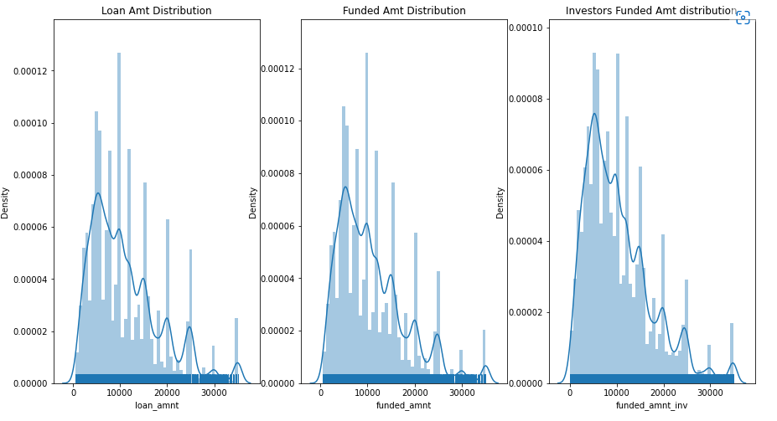

Slide 10
Bivariate Analysis
Following are the variables considered for bivariate analysis.
Purpose of loan
Loan amount
Interest rate

Slide 11
Results of Bivariate Analyses

Slide 12
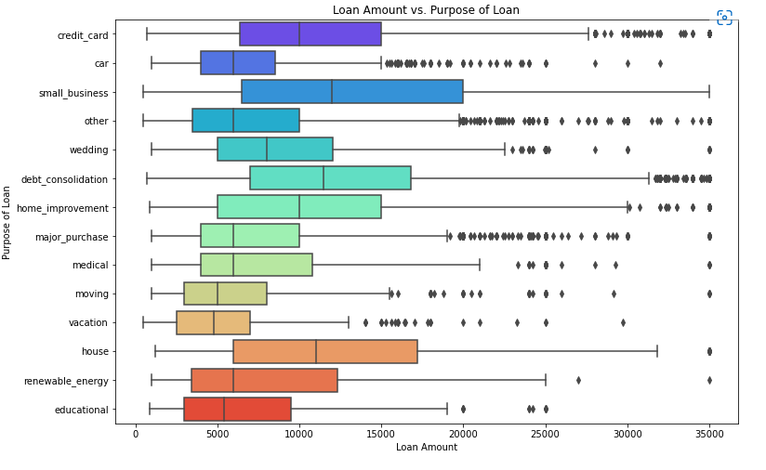
Observations from Bivariate Analysis loan Amount vs. purpose of loan
Majority of the loan amount and high amount of loan is issued for small scale business

Slide 13
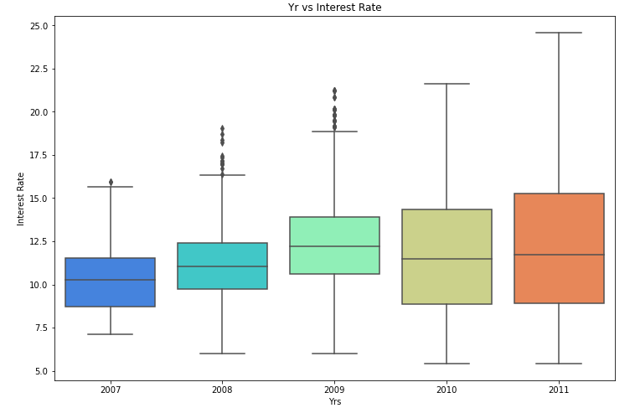
Observations from Bivariate Analysis interest rate vs year
Year on year the rate of interest keeps on rising

Slide 14
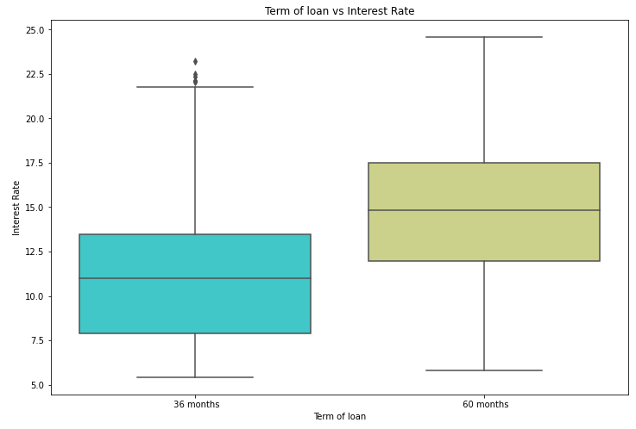
Observations from Bivariate Analysis term of years vs interest rates
Interest rate is high for more term period

Slide 15
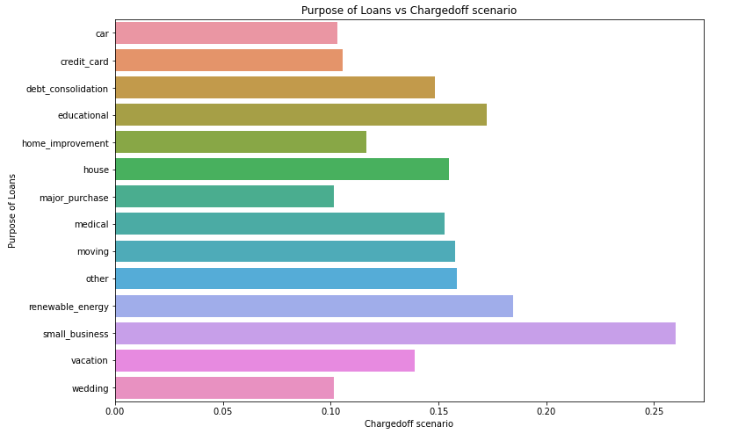
Observations from Bivariate Analysis
Purpose of loan vs. Charged off proportion
Small scale business organisations have high risk of charge off

Slide 16
Conclusions
From the EDA analysis performed on the data provided the inferences are as below, there is likely to be charged off scenario in the following cases.
If the income and loan amount are in above .
More interest rate for more repayment period
Small scale business are likely to be charged off

Slide 17
Thank You.

